Slide 1
Diabetes Prediction
Data Science Project
By Aljowhara Alblaihed

Slide 2
TABLE OF CONTENTS
1
2
Business Problem
What is Diabetes
3
Process
4
Model Results
5
Next Step
6
Tools

Slide 3
1
What is Diabetes

Slide 4

What is Diabetes
Diabetes is a chronic (long-lasting) health condition that affects how your body turns food into energy. Most of the food you eat is broken down into sugar (also called glucose) and released into your bloodstream. When your blood sugar goes up, it signals your pancreas to release insulin. Insulin acts like a key to let the blood sugar into your body’s cells for use as energy. If you have diabetes, your body either doesn’t make enough insulin or can’t use the insulin it makes as well as it should. When there isn’t enough insulin or cells stop responding to insulin, too much blood sugar stays in your bloodstream.

Slide 5
2
Business Problem

Slide 6
Business Problem
Project objective is to predict whether the patient has diabetes or not based on various features includes Number of times pregnant, Glucose, Blood Pressure, skin Thickness, Insulin, BMI, Family history of diabetes and Age.

Slide 7
3
Process

Slide 8
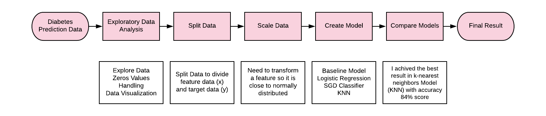
Process

Slide 9
4
Model Results

Slide 10
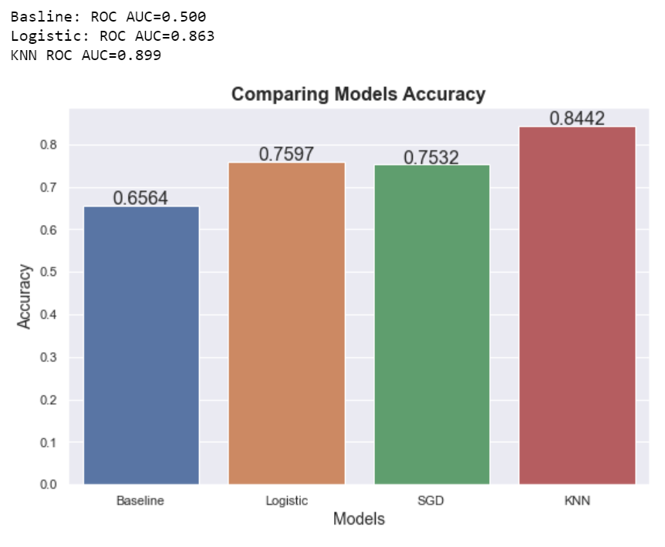
Model Result
I achieved the best result in k-nearest neighbors Model with accuracy 84% score and ROC AUC 90%.
Baseline accuracy 65.6% score.
High correlation between Outcome are Glucose, BMI and Age.

Slide 11
5
Next Step

Slide 12
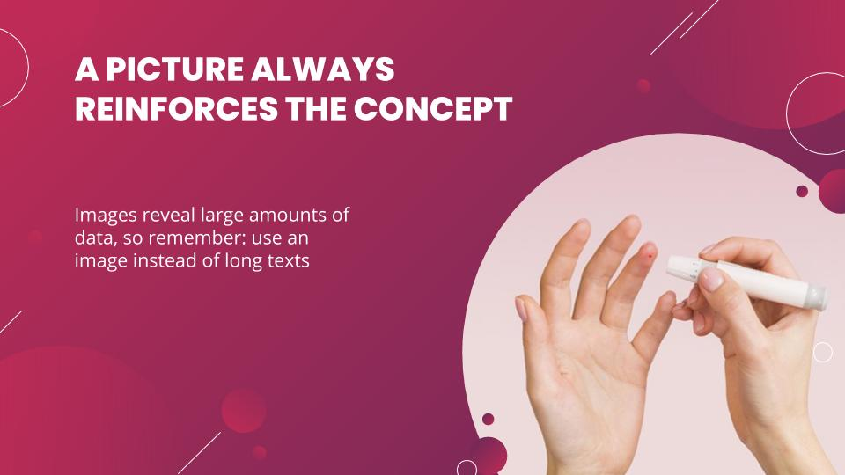
Next Step
Step 1
Step 2
Add more features for more accuracy result, the features are Sex and Type of diabetes.
Make a website/app for help diabetics to knowledge all information about diabetes, can communication with doctors any time and this web/app have all data about diabetics.

Slide 13
6
Tools

Slide 14





Tools

Slide 15
Thank you
Project Link: https://github.com/AljowharaAlblaihed/Diabetes-Prediction-Data-Science-Project

